Slide 1

TWITTER - AWS ANALYSIS
By David Masterson, Page Tyler, Nick Rau, Zeshawn Manzoor

Slide 2
CHALLENGES
Given a list of negative keywords, what is the frequency of these words appearing in a twitter stream?
Can we capture trending tweets from twitter?
Given an input stream, what is the most referenced url?

Slide 3





TECHNOLOGIES
1. Amazon Web Service
2. sbt
3. Scala 2.12.13
4. Apache Spark 3.0.0
5. YARN 1.0
6. Hadoop File system 2.10

Slide 4
FEATURES
TweetNegativity – Creates dataframe count of negative words in a given twitter stream
TrendingTweets – Retrieves most liked tweet given the stream of tweets
MostMentionedUrl - Given a stream, outputs the url with the most mentions

Slide 5
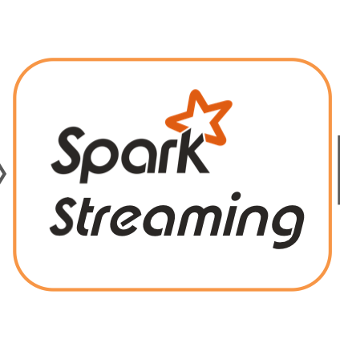



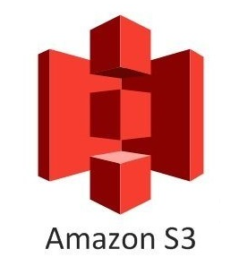
PROCESS
Input Stream
Copy the jar from s3
Assemble script as a jar file
Run SparkSession on the dataset
Send the jar file script to s3
Send output to s3 bucket

Slide 6
Spark Streaming:
Page Tyler

Slide 7
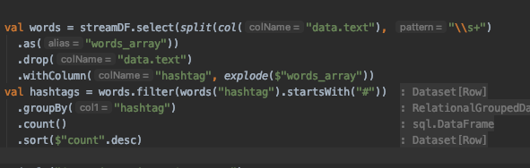
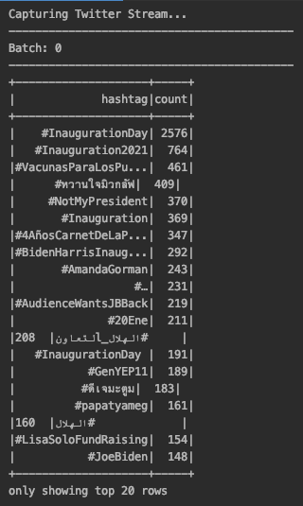
TWEETS TRENDING
Real time data deliver through an open, streaming API connection. Rather than delivering data in batches through repeated requests by your client app, as might be expected from a REST API, a single connection is opened between your app and the API, with new results being sent through that connection whenever new matches occur. This results in a low-latency delivery mechanism that can support very high throughput.

Slide 8
WARNING: EXPLICIT CONTENT

Slide 9
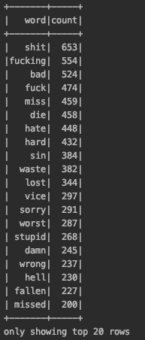
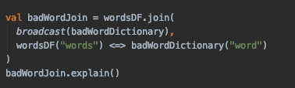
NEGATIVITY TRENDING
Inaugural Word count – At the beginning of President Biden’s inaugural speech, we ran our stream for one hour to get the distribution of “negative” words
This followed the basic MapReduce method, each keyword was mapped when it appeared in a tweet and the dataset was reduced into distinct elements
As you can see, twitter is not the best place to go find some positivity

Slide 10
AWS: S3 & EMR
David Masterson

Slide 11
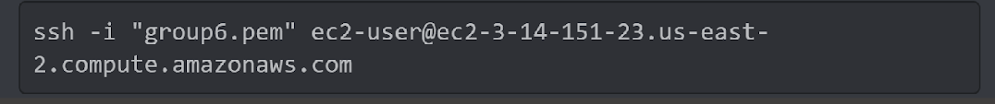
PROCESS
Amazon EMR uses an Amazon Elastic Compute Cloud (Amazon EC2) key pair to ensure that you alone have access to the instances that you launch. The PEM file associated with this key pair is required to ssh directly to the master node of the cluster.
We would utilize ssh in order to access the master node of the cluster
We copy the jar from s3 into the EMR local system and run spark on the dataset

Slide 12
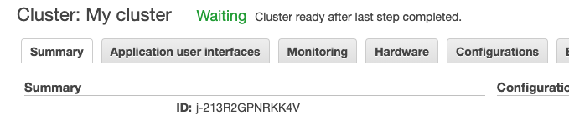


Create your EMR and select the software that you would like pre-installed.
Once it is ready it goes to a waiting state.
Connect to master node using SSH will show.
Make sure your log URI contains a location to your S3 bucket.

Slide 13

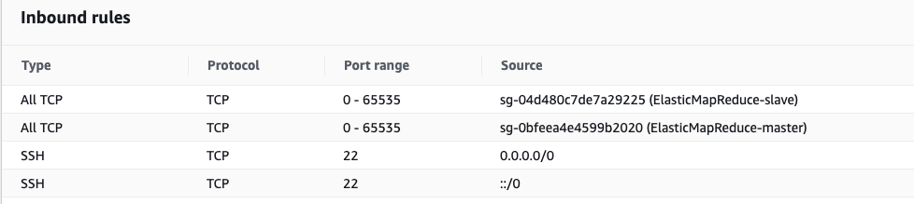
Change your security setting to have ssh as an inbound rule and source to be from anywhere. (Anywhere is only if your testing … not for prod)

Slide 14
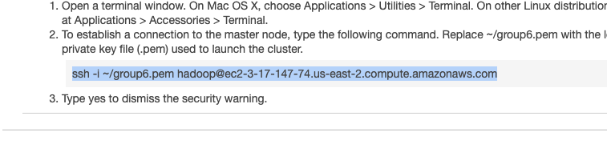
Click on the ssh into master hyperlink and it will take you to this screen giving you the command to type into your terminal.
Make sure you have a key pair set up. Creating an AWS KeyPair

Slide 15
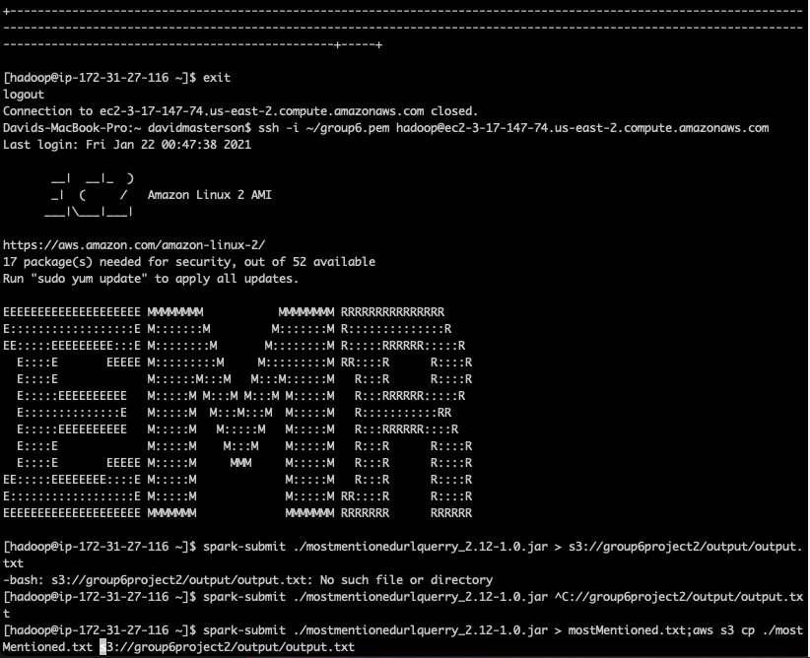
This is the full command to run the jar and output to a txt file
Sends output.txt to the s3
Notes:
This is the full command to run the jar and output to a txt file, and then send to s3.

Slide 16
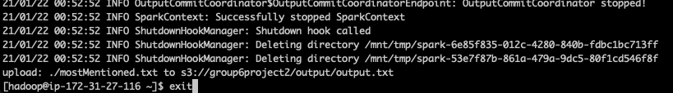
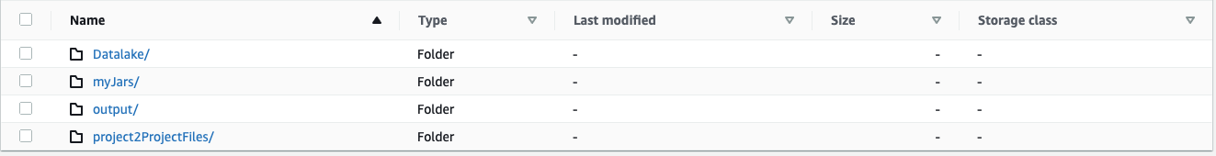
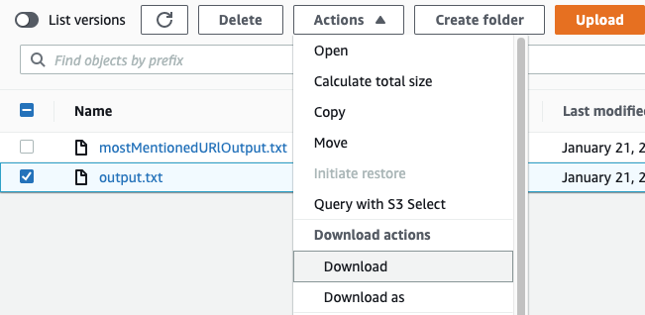
When done running, exit your ssh connection and go to your output folder
Select your file and download
Notes:
When done running, exit your ssh connection and go to your output folder.
Select your file and download.

Slide 17
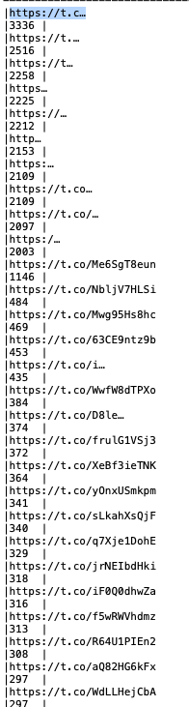
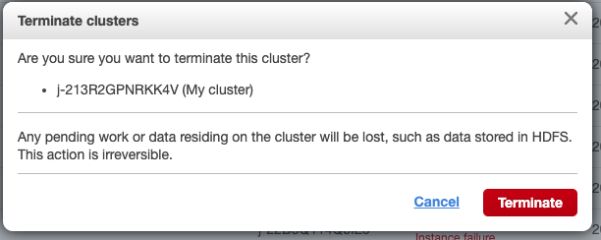
Example of the output - make sure to terminate your EMR cluster to keep from receiving unexpected charges.
Notes:
example of the output and make sure to terminate your EMR cluster to keep from receiving unexpected charges.

Slide 18
OBSTACLES
Collecting Twitter stream and finding out which bulk data we wanted to use was challenging
Figuring out what questions to answer given only brief information about a user and their tweet
Setting up the ec2 server and s3 bucket to collect the data
Finding out how to distinguish between a negative & positive tweet was intriguing because we didn’t know what metric to use
Allowing spark to read the input found in Hadoop binaries

Slide 19
DISCUSSION
AWS s3 bucket proved to be very helpful in collecting bulk data
Among the bulk 2020 data, separate files of each month were concatenated into one file
List of negative keywords was taken from an outside source. Theoretically the function could work with any set of keywords
If given more time, we would develop a function to find out how related 2 users are by comparing their followers list (Bacon’s Law)
Perhaps in the future we could have a function that filters out negative tweets

Slide 20
Bowling Pins - Attempt
First thought was a minimax algorithm.
Minimax tree is too large
If n=300, there are 599 possible first moves.
After 5 turns, there are at least 70 trillion possible board states
New idea after some research
Start with a board in win state
Go through possible moves backwards
Root is labeled, P for ‘Previous player wins’
Alternating between P and N where N is ‘Next player wins’
If there is an instance of original board state labeled N, the first player wins.
Realized that this method is not much more efficient than minimax…
P
X | X
N
I | X
X | I
N
I | I
I | I
N
I | I
P
P

Slide 21
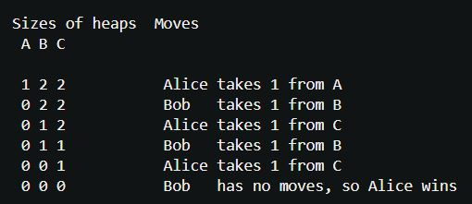
Bowling Pins – Best Solution?
Sprague-Grundy Theorem
For every impartial game there is an equivalent game of Nim
The ultimate solution is to generate the ‘Nimber’ or ‘Grundy Number’
If the nimber is 0 then the second player wins.
For small games, the nimber is easy to calculate
Consider the set of possible sizes of a heap after a move
The nimber is the minimum excludant of that set
Take the Grundy Sum of each heap’s nimber
Unfortunately, the equivalent game of Nim is not clear
Bowling Pins does not have clearly defined heaps
The position of pins matters

